Slide 1
CHAPTER 6 GRAPHS
All the programs in this file are selected from
Ellis Horowitz, Sartaj Sahni, and Susan Anderson-Freed
“Fundamentals of Data Structures in C”,

Slide 2
Konisgberg Bridge Problem
柯尼斯堡七橋問題
C
c
g
d
D
e
A
b
f
a
B

Slide 3
Euler’s Graph
Degree of a vertex: the number of edges incident to it
Euler showed that there is a walk starting at any vertex, going through each edge exactly once and terminating at the start vertex iff the degree of each vertex is even
This walk is called Eulerian cycle
No Eulerian cycle for the Konigsberg bridge problem since all four vertices are of odd edges

Slide 4
Applications of Graphs
Analysis of electrical circuits
Finding shortest routes
Project planning
Identification of chemical compounds
Statistical mechanics
Genetics
Cybernetics
Linguistics
Social Sciences
…

Slide 5
Definition
A graph, G, consists of two sets
A finite, nonempty set of vertices V(G)
A finite, possible empty set of edges E(G)
G = (V, E) represents a graph
An undirected graph is one in which the pair of vertices in a edge is unordered, (u, v) = (v, u)
A directed graph is one in which each edge is a directed pair of vertices, <u, v> != <v, u>
tail
head
u
v

Slide 6
Adjacent and Incident
If (u, v) is an edge (or arc) in an undirected graph,
u and v are adjacent
The edge (u, v) is incident on vertices u and v
If <u, v> is an edge in a directed graph
u is adjacent to v, and v is adjacent from u
The edge <u, v> is incident on u and v

Slide 7
Examples for Graph
0
0
0
1
2
1
2
1
3
3
4
5
6
G₁
2
G₂
G₃
V(G₁)={0,1,2,3} E(G₁)={(0,1),(0,2),(0,3),(1,2),(1,3),(2,3)}
V(G₂)={0,1,2,3,4,5,6} E(G₂)={(0,1),(0,2),(1,3),(1,4),(2,5),(2,6)}
V(G₃)={0,1,2} E(G₃)={<0,1>,<1,0>,<1,2>}

Slide 8
Graph Restrictions
Edges/Vertices of a graph → usually defined as a set → imposed restrictions
No self/same edges
0
0
2
1
3
1
2
self edge
multigraph:
multiple occurrences
of the same edge
(a)
(b)
*Figure 6.3: Examples of graph-like structures (p.268)

Slide 9
Complete Graph
A complete graph is a graph that has the maximum number of edges
For undirected graph with n vertices, the maximum number of edges is n(n-1)/2
For directed graph with n vertices, the maximum number of edges is n(n-1)
Example: G₁ is a complete graph

Slide 10
Complete Graph
0
0
0
1
2
1
2
1
3
3
4
5
6
G₁
2
G₂
complete graph
incomplete graph
G₃

Slide 11
Subgraph
A subgraph of G is a graph G’ such that V(G’) is a subset of V(G) and E(G’) is a subset of E(G)
0
0
0
1
2
0
1
2
1
2
3
1
2
3
3
G₁
(i) (ii) (iii) (iv)
(a) Some of the subgraph of G₁
Figure 6.4: Subgraphs of G₁ (p.269)

Slide 12
Figure 6.4: Subgraphs of G₃ (p.269)
Subgraph
A subgraph of G is a graph G’ such that V(G’) is a subset of V(G) and E(G’) is a subset of E(G)
0
0
0
0
0
1
1
1
1
2
2
2
(i) (ii) (iii) (iv)
(b) Some of the subgraph of G₃
G₃

Slide 13
Path and Cycle
A path from vertex u to vertex v in a graph G, is a sequence of vertices, u, i₁, i₂, ..., i_{k}, v, such that (u, i₁), (i₁, i₂), ..., (i_{k}, v) are edges in an undirected graph
Length of a path: the number of edges on it
Simple Path: a path in which all vertices are distinct except possibly the first and last
Cycle: a simple path in which the first and the last vertices are the same
Notes:
有的書會稱 path 是 walk

Slide 14
Connectivity
In an undirected graph G, two vertices, u and v, are connected if there is a path in G between u and v
A (connected) component of an undirected graph is a maximal connected subgraph
An undirected graph is connected if, for every pair of distinct vertices u, v, there is a path from u to v

Slide 15
connected component (maximal connected subgraph)
H₁
0
H₂
4
2
1
5
3
6
7
G₄ (not connected)
*Figure 6.5: A graph with two connected components (p.270)

Slide 16
Connected Component
A tree is a graph that is connected and acyclic (i.e., has no cycles)
A directed graph is strongly connected if there is a directed path from u to v and also from v to u
A strongly connected component is a maximal subgraph that is strongly connected

Slide 17
Connected Component
0
0
1
2
1
2
3
3
4
5
6
G1
G2
tree (acyclic graph)

Slide 18
Connected Component
not strongly connected
strongly connected component
(maximal strongly connected subgraph)
0
0
2
1
2
1
G3
*Figure 6.6: Strongly connected components of G₃ (p.262)

Slide 19
Degree
The degree of a vertex is the number of edges incident to that vertex
Moreover, for directed graphs,
in-degree of a vertex v: the number of edges that have v as the head (i.e., number of incoming edges)
out-degree of a vertex v: the number of edges that have v as the tail (i.e., number of outgoing edges)
If d_{i} is the degree of a vertex i in an undirected graph G with n vertices and e edges, the number of edges is
tail
head
u
v

Slide 20
Degree
3
0
undirected graph
0
2
1
2
3
1
2
3
3
3
3
4
5
6
3
3
1
1
G₁
1
G₂
1
0
in:1, out: 1
directed graph
in-degree
out-degree
1
in: 1, out: 2
2
in: 1, out: 0
G₃

Slide 21
ADT for Graph
ADT Graph is
objects: a nonempty set of vertices and a set of undirected edges, where each edge is a pair of vertices
functions: for all graph ∈ Graph, v, v₁ and v₂ ∈ Vertices
Graph Create() ::= return an empty graph
Graph InsertVertex(graph, v) ::= return a graph with v inserted. v has no incident edge
Graph InsertEdge(graph, v₁, v₂) ::= return a graph with new edge between v₁ and v₂
Graph DeleteVertex(graph, v) ::= return a graph in which v and all edges incident to it are removed
Graph DeleteEdge(graph, v₁, v₂) ::= return a graph in which the edge (v₁, v₂) is removed. Leave the incident nodes in the graph
Boolean IsEmpty(graph) ::= if (graph==empty graph) return TRUE
else return FALSE
List Adjacent(graph, v) ::= return a list of all vertices that are adjacent to v

Slide 22
Graph Representations
Adjacency Matrix
Adjacency Lists
Adjacency Multilists

Slide 23
Adjacency Matrix
Let G=(V, E) be a graph with n vertices
The adjacency matrix of G is a two-dimensional n by n array, say a
If the edge (i, j) is in E(G), a[i][j]=1
If there is no such edge in E(G), a[i][j]=0
The adjacency matrix for an undirected graph is symmetric; the adjacency matrix for a digraph may not be symmetric

Slide 24
Examples for Adjacency Matrix
4
0
0
5
1
2
0
2
1
6
3
3
1
7
2
G₁
G₂
Space: O(n²)
Good for dense
Bad for sparse
symmetric
G₄

Slide 25
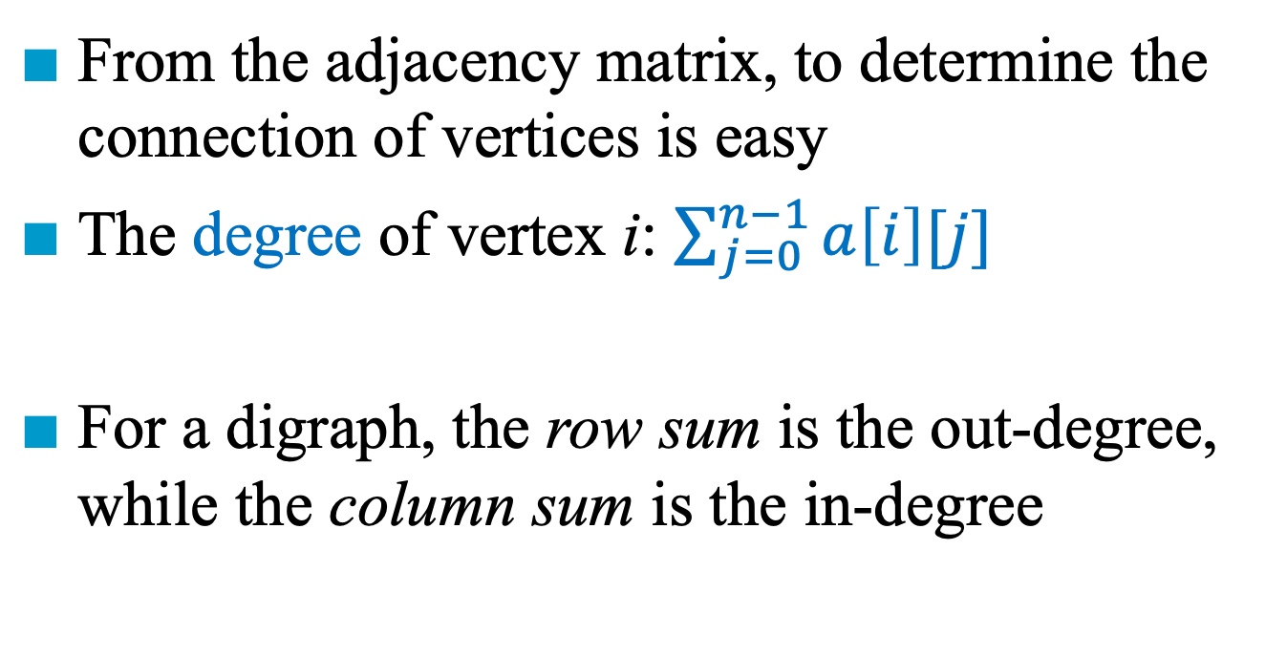
Merits of Adjacency Matrix
From the adjacency matrix, to determine the connection of vertices is easy
The degree of vertex i: $\sum_{j=0}^{n−1}{a\left[i\right][j]}$
For a digraph, the row sum is the out-degree, while the column sum is the in-degree

Slide 26
Sequential Representation
0
4
node[0] … node[n-1]: starting point for vertices
node[n]: n+2e+1
node[n+1] … node[n+2e]: head node of edge
2
1
5
3
6
7
0
4
5
1
6
2
7
3

Slide 28
Adjacency Lists
Let G=(V, E) be a graph with n vertices
The n rows of the adjacency matrix are represented as n chains
The data field of a chain node stores the index of an adjacent node
An array adjLists is used so that we can access the adjacency list for any vertex in O(1) time
adjLists[i] is a pointer to the first node in the adjacency list for vertex i

Slide 29
Data Structures for Adjacency Lists
Each row in adjacency matrix is represented as an adjacency list.
#define MAX_VERTICES 50
typedef struct node *nodePointer;
typedef struct node {
int vertex;
nodePointer link;
};
nodePointer graph[MAX_VERTICES];
int n=0; /* vertices currently in use */

Slide 30
0
0
4
2
1
5
1
2
3
6
3
7
0
1
2
3
1
2
3
0
1
2
3
4
5
6
7
1
2
0
2
3
0
3
0
1
3
0
3
0
1
2
1
2
G₁
0
5
4
6
0
1
2
1
5
7
0
2
1
6
G₃
G₄
2
An undirected graph with n vertices and e edges ➔ n head nodes and 2e list nodes

Slide 31
Operations
degree of a vertex in an undirected graph
# of nodes in its adjacency list ➔ O(n)
# of edges in a graph
determined in O(n+e)
out-degree of a vertex in a directed graph
# of nodes in its adjacency list
in-degree of a vertex in a directed graph
Scan the entire data structure

Slide 32
*Figure 6.10: Inverse adjacency list for G₃ (p.275)
Inverse Adjacency Lists
To resolve the issue of adjacency list for directed graph
Determine in-degree of a vertex in a fast way.
0
0
1
2
•
•
•
1 NULL
1
0 NULL
1 NULL
2

Slide 33
Figure 6.11: Orthogonal representation for graph G₃(p.276)
Orthogonal Representation
Header nodes
(shown twice)
0
1
2
0
0
0 1 NULL NULL
1
1
1 0 NULL
1 2 NULL NULL
2
2 NULL

Slide 35
Adjacency Multilists
An edge (u, v) in an undirected graph is represented by two entries in adjacency list representation
One on the list for u and the other on the list for v
Adjacency Multilists
Lists in which nodes may be shared among several lists. (an edge is shared by two different links)
marked vertex1 vertex2 link1 link2

Slide 36
Example for Adjacency Multlists
(1,0)
0
1
2
3
N0
N1
N2
N3
N4
N5
0 1 N1 N3
edge (0,1)
edge (0,2)
edge (0,3)
edge (1,2)
edge (1,3)
edge (2,3)
(2,0)
0 2 N2 N3
(3,0)
0 3 N4
(2,1)
1 2 N4 N5
0
(3,1)
1 3 N5
1
2
(3,2)
2 3
3
six edges
Lists: vertex 0: N0->N1->N2
vertex 1: N0->N3->N4
vertex 2: N1->N3->N5
vertex 3: N2->N4->N5

Slide 37
Adjacency Multilists
typedef struct edge *edgePointer;
typedef struct edge {
short int marked;
int vertex1, vertex2;
edgePointer link1, link2;
};
edgePointer graph[MAX_VERTICES];
marked vertex1 vertex2 link1 link2

Slide 39
Weighted Edges
In many applications, the edges of a graph have weights associated with them
Distance from one vertex to another
Cost of going from one vertex to an adjacent vertex
To represent an edge-weighted graph:
Adjacency matrix entries a[i][j] keep the weights
Adjacency list includes an additional field, weight
A graph with weighted edges is called a network

Slide 41
Graph Operations
Traversal Given G = (V, E) and vertex v, find all vertices in G that are reachable from v
Depth First Search (DFS) preorder tree traversal
Breadth First Search (BFS) level order tree traversal
Connected Components
Spanning Trees

Slide 42
Depth-First Search
Generalization of preorder traversal of a tree
Steps:
Starting from vertex v
Select an unvisited vertex w, from v’s adjacency list, and continue searching on w
Push the current position in v’s adjacency list to a stack
Pop and obtain the previous position from the stack and continue processing its adjacency list, if the current visited vertex has no unvisited neighboring vertices
To avoid cycles, mark visited vertices (true/false)

Slide 43
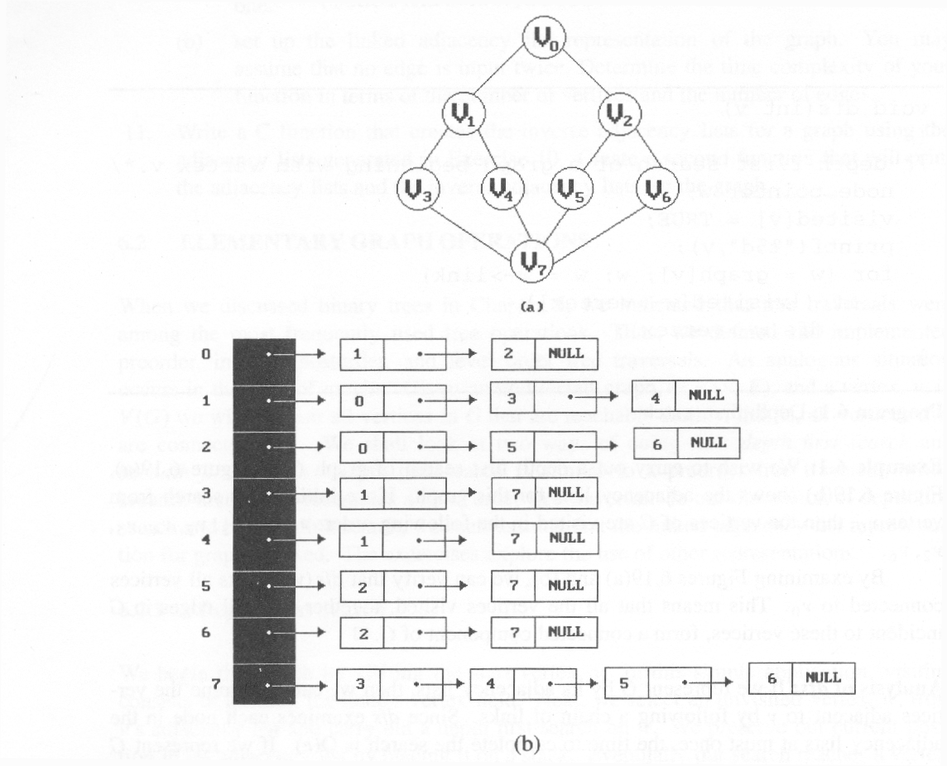
Depth First Search: v0
*Figure 6.16: Graph G and its adjacency lists (p.281)

Slide 44
Depth First Search: v0, v1
*Figure 6.16: Graph G and its adjacency lists (p.281)

Slide 45
Depth First Search: v0, v1, v3
*Figure 6.16: Graph G and its adjacency lists (p.281)

Slide 46
Depth First Search: v0, v1, v3, v7
*Figure 6.16: Graph G and its adjacency lists (p.281)

Slide 47
Depth First Search: v0, v1, v3, v7, v4
*Figure 6.16: Graph G and its adjacency lists (p.281)

Slide 48
Depth First Search: v0, v1, v3, v7, v4, v5
*Figure 6.16: Graph G and its adjacency lists (p.281)

Slide 49
Depth First Search: v0, v1, v3, v7, v4, v5, v2
*Figure 6.16: Graph G and its adjacency lists (p.281)

Slide 50
Depth First Search: v0, v1, v3, v7, v4, v5, v2, v6
*Figure 6.16: Graph G and its adjacency lists (p.281)

Slide 51
Depth First Search (Recursive)
#define FALSE 0
#define TRUE 1
typedef struct node *nodePointer;
typedef struct node {
int vertex;
nodePointer link;
};
nodePointer graph[MAX_VERTICES];
short int visited[MAX_VERTICES];
Data structure
adjacency list: O(e)
adjacency matrix: O(n²)
void dfs(int v)
{
nodePointer w;
visited[v]= TRUE;
printf(“%5d”, v);
for (w=graph[v]; w; w=w->link)
if (!visited[w->vertex])
dfs(w->vertex);
}

Slide 52
Breadth First Search
Generalization of level-order traversal of a tree
Steps:
Starting from vertex v
Visit each of the vertices on v’s adjacency list and add them in the queue sequentially
Delete and obtain a vertex w from the queue and continue search on w, when all the vertices of v’s adjacency list are visited
To avoid cycles, mark visited vertices (true/false)

Slide 53
Breadth First Search: v0, v1, v2, v3, v4, v5, v6, v7
*Figure 6.19: Graph G and its adjacency lists (p.281)

Slide 54
Breadth First Search: v0, v1, v2, v3, v4, v5, v6, v7
*Figure 6.19: Graph G and its adjacency lists (p.281)

Slide 55
Breadth First Search: v0, v1, v2, v3, v4, v5, v6, v7
*Figure 6.19: Graph G and its adjacency lists (p.281)

Slide 56
Breadth First Search: v0, v1, v2, v3, v4, v5, v6, v7
*Figure 6.19: Graph G and its adjacency lists (p.281)

Slide 57
Breadth First Search: v0, v1, v2, v3, v4, v5, v6, v7
*Figure 6.19: Graph G and its adjacency lists (p.281)

Slide 58
Breadth First Search: v0, v1, v2, v3, v4, v5, v6, v7
*Figure 6.19: Graph G and its adjacency lists (p.281)

Slide 59
Breadth First Search: v0, v1, v2, v3, v4, v5, v6, v7
*Figure 6.19: Graph G and its adjacency lists (p.281)

Slide 60
Breadth First Search: v0, v1, v2, v3, v4, v5, v6, v7
*Figure 6.19: Graph G and its adjacency lists (p.281)

Slide 61
Breadth First Search
typedef struct queue *queuePointer;
typedef struct queue {
int vertex;
queuePointer link;
};
short int visited[MAX_VERTICES];
QueuePointer front, rear;
void addq(int);
int deleteq();

Slide 62
Breadth First Search (Continued)
void bfs(int v)
{
nodePointer w;
front = rear = NULL;
printf(“%5d”, v);
visited[v] = TRUE;
addq(v);

Slide 63
Breadth First Search (Continued)
while (front) {
v = deleteq();
for (w=graph[v]; w; w=w->link)
if (!visited[w->vertex]) {
printf(“%5d”, w->vertex);
addq(w->vertex);
visited[w->vertex] = TRUE;
}
}
}
adjacency list: O(e)
adjacency matrix: O(n²)

Slide 65
Connected Components
Determine whether or not an undirected graph is connected
We can implement this operation by simply calling DFS or BFS
Examine if there is any unvisited vertex
0
4
2
1
5
3
6
7

Slide 66
Connected Components
Determine whether or not an undirected graph is connected
We can implement this operation by simply calling DFS or BFS ➔ O(e)
Examine if there is any unvisited vertex ➔ O(n)
Complexity = O(e + n)
0
4
2
1
5
3
6
7

Slide 67
Find Connected Components
void connected(void)
{
for (i=0; i<n; i++) {
if (!visited[i]) {
dfs(i);
printf(“\n”);
}
}
}
adjacency list: O(n+e)
adjacency matrix: O(n²)

Slide 69
Spanning Trees
A spanning tree is any tree that consists solely of edges in G and that includes all the vertices
A minimal connected subgraph, G’, of G such that V(G’)=V(G) (i.e., with the minimal number of edges)
The number of edges is n-1
E(G): T (tree edges) + N (nontree edges) where T: set of edges used during search N: set of remaining edges

Slide 70
Examples of Spanning Tree
0
0
0
0
1
2
1
2
1
2
1
2
3
3
3
3
G1
Possible spanning trees

Slide 71
Spanning Trees
Either dfs or bfs can be used to create a spanning tree
Select the edges that are visited sequentially
When dfs is used, the resulting spanning tree is known as a depth first spanning tree
When bfs is used, the resulting spanning tree is known as a breadth first spanning tree
While adding a non-tree edge into any spanning tree, this will create a cycle

Slide 72
DFS vs BFS Spanning Tree
0
0
0
1
2
1
2
1
2
3
4
5
6
3
4
5
6
3
4
5
6
7
7
nontree edge
No cycle in the tree
7
DFS Spanning
BFS Spanning

Slide 74
Articulation Point
An articulation point (or cut vertex) is a vertex v of G such that the deletion of v, together with all edges incident on v, produces a graph, G’, which has at least two connected components
0
8 9
1
7
2
3
5
4
6
Notes:
Articulation point 關節點

Slide 75
0
8 9
Connected graph
with articulation points
1
7
2
3
5
Node 3 is a cut vertex
Remove node 3
➔ Two connected components
Node 2 is not a cut vertex
Remove node 2
➔ One connected component
4
6
8 9
0
8 9
0
7
7
1
1
2
5
3
5
4
6
4
6

Slide 76
Biconnected Graphs
A biconnected graph is a connected graph that has no articulation points
0
1
2
3
4
5
6
7

Slide 77
Biconnected Components
Biconnected component: a maximal connected subgraph H of G (no subgraph of G that is both biconnected and properly contains H)
0
8
9
0
8 9
1
7
7
1
7
7
2
1
3
5
2
3
3
5
5
4
6
4
6
Biconnected components

Slide 78
Find Biconnected Components
Goal: find all biconnected components of G
Observations:
Two biconnected components of the same graph have at most one vertex in common (i.e., cut vertex)
It implies that no edge can be in two or more biconnected components (i.e., they are disjoint sets)

Slide 79
Find Biconnected Components
Check whether a node is an articulation point
How and why?
0
8 9
1
7
2
3
5
4
6

Slide 80
Find Biconnected Components
Check whether a node is an articulation point
Starting from a node v, DFS traverses all the reachable nodes through some certain edge e before going back to v through e
8 9
4 0
9 8 9 8
0
7
7 7
1
3
1
2
0 5
3 5
3
5
2 2
4
6
4 6
1 6
Depth first number (dfn): The sequence where the vertices are visited during the depth first search

Slide 81
Find Biconnected Components
Check whether a node is an articulation point
The root of a DFS spanning tree is an articulation point iff it has at least two children
0
3
1 5
4
5
2
4
2
6
7
6
3
1
7
8 9
0
9
8

Slide 82
Find Biconnected Components
Every non-tree edge (u, v) is a back edge
Either u is an ancestor of v or v is an ancestor of u on the DFS spanning tree
Why?
0
3
1 5
4
5
nontree
edge
(back edge)
nontree
edge
(back edge)
2
4
2
6
7
6
3
1
7
8 9
0
9
8

Slide 83
Find Biconnected Components
All the non-tree edges are back edges
No crossing edge is possible since DFS traverses the entire connected component through an edge of a node
0
3
1 5
4
5
nontree
edge
(back edge)
nontree
edge
(back edge)
2
4
2
6
7
6
3
1
7
8 9
0
9
8

Slide 84
Find Biconnected Components
Check whether each remaining node is an articulation point without using DFS again
How and why?
0
3
1 5
4
5
nontree
edge
(back edge)
nontree
edge
(back edge)
2
4
2
6
7
6
3
1
7
8 9
0
9
8

Slide 85
Find Biconnected Components
Check whether each remaining node is an articulation point without using DFS again
Removing an articulation point separates a graph into two components ➔ Only the node can connect the two components
0
3
1 5
4
5
nontree
edge
(back edge)
nontree
edge
(back edge)
2
4
2
6
7
6
3
1
7
8 9
0
9
8

Slide 86
Find Biconnected Components
Check whether each remaining node u is an articulation point without using DFS again
u → articulation point iff u has a child w such that w cannot reach an ancestor of u using a path that consists of w, descendants of w, and a single back edge in the tree
0
3
1 5
4
5
nontree
edge
(back edge)
nontree
edge
(back edge)
2
4
2
6
7
6
3
1
7
8 9
0
9
8

Slide 87
Find Biconnected Components
We define low for each vertex u of G such that low(u) is the lowest dfn that we can reach from u using a path of descendants followed by at most one back edge
0
0
3
1 5
4
0
5
5
nontree
edge
(back edge)
nontree
edge
(back edge)
2
4
2
0
6
7
6
5
3
1
0
7
5
9
8 9
0
4
8
9
8

Slide 88
Find Biconnected Components
We define low for each vertex u of G, where low(u) = min{ dfn(u), min{low(w) | w is a child of u},
min{dfn(w) | (u, w) is a back edge} }
0
0
3
1 5
4
0
5
5
nontree
edge
(back edge)
nontree
edge
(back edge)
2
4
2
0
6
7
6
5
3
1
0
7
5
9
8 9
0
4
8
9
8

Slide 89
Find Biconnected Components
Check whether each remaining node u is an articulation point
u is an articulation point iff u has a child w such that low(w) ≥ dfn(u)
0
0
3
1 5
4
0
5
5
nontree
edge
(back edge)
nontree
edge
(back edge)
2
4
2
0
6
7
6
5
3
1
0
7
5
9
8 9
0
4
8
9
8

Slide 90
*Figure 6.21: dfn and low values for dfs spanning tree with root =3 (p.288)

Slide 91
Find Biconnected Components
A node u is an articulation point iff u is either
the root of the spanning tree and has two or more children, or
u is not the root and u has a child w such that low(w) ≥ dfn(u)

Slide 92
*Program 6.5: Initializaiton of dfn and low (p.289)
Implementation
#define FALSE 0
#define TRUE 1
typedef struct node *nodePointer;
typedef struct node {
int vertex;
nodePointer link;
};
nodePointer graph[MAX_VERTICES]; // storing the neighbors
#define MIN2(x,y) (((x) < (y))?(x):(y)) short int dfn[MAX_VERTICES]; short int low[MAX_VERTICES]; int num; // for dfn void init(void) { int i; for (i = 0; i < n; i++) { dfn[i] = low[i] = -1; } num = 0; }

Slide 93
*Program 6.4: Determining dfn and low (p.289)
// initial call: dfn(3,-1)
// since v3 is the root (without parent)
void dfnlow(int u, int v)
{ /* compute dfn and low while performing a dfs search beginning at vertex u, v is the parent of u (if any) */ nodePointer ptr; int w;
dfn[u] = low[u] = num ++; for (ptr = graph[u]; ptr; ptr = ptr ->link) { w = ptr ->vertex; if (dfn[w] < 0) { /*w is an unvisited vertex */ dfnlow(w, u); low[u] = MIN2(low[u], low[w]); }
else if (w != v) low[u] = MIN2(low[u], dfn[w] ); } }
// low[u]=min{dfn(u), …}
v
u
w
v
u
// low[u]=min{…, min{low(w)|w is a child of u}, …}
// if dfn[w] ≠ -1 and w is not parent→ edge vw is a back edge
X
O
// low[u]=min{…, …, min{dfn(w)|(u,w) is a back edge}

Slide 94
*Program 6.6: Biconnected components of a graph (p.290)
void bicon(int u, int v) { /* compute dfn and low, and output the edges of G by their biconnected components, v is the parent (if any) of the u in the resulting spanning tree. It is assumed that all entries of dfn[] have been initialized to -1, num is initialized to 0, and the stack is initially empty */ nodePointer ptr; int w, x, y; dfn[u] = low[u] = num ++; for (ptr = graph[u]; ptr; ptr = ptr->link) { w = ptr ->vertex; if ( v != w && dfn[w] < dfn[u] ) push(u, w); /* add edge to stack */
// low[u]=min{dfn(u), …}
// (1) dfn[w] = -1 → First-time visited
// (2) dfn[w] != -1 → Back edge

Slide 95
if(dfn[w] < 0) { /* w has not been visited */ bicon(w, u); low[u] = MIN2(low[u], low[w]); if (low[w] >= dfn[u] ){ /* articulation point */ printf(“New biconnected component: “); do { /* delete edge from stack */ pop(&x, &y); printf(“ <%d, %d>” , x, y); } while (!(( x = = u) && (y = = w))); printf(“\n”); } } else if (w != v) low[u] = MIN2(low[u], dfn[w]); } }
// low[u]=min{…, min{low(w)|w is a child of u}, …}
// low[u]=min{…, …, min{dfn(w)|(u,w) is a back edge}}
*Program 6.6: Biconnected components of a graph (p.290)

Slide 96
0
0
3
1 5
4
5
2
4
2
6
7
6
3
1
0
7
low(u) = min{ dfn(u), min{low(w) | w is a child of u},
min{dfn(w) | (u, w) is a back edge} }
8 9
0
9
8

Slide 98
Minimum Cost Spanning Tree
The cost of a spanning tree of a weighted undirected graph is the sum of the costs of the edges in the spanning tree
A minimum cost spanning tree is a spanning tree of least cost
Three different greedy algorithms can be used
Kruskal
Prim
Sollin
Select n-1 edges from a weighted graph
of n vertices with minimum cost

Slide 99
Greedy Strategy
An optimal solution is constructed in stages
At each stage, the best decision is made at this time
Since this decision cannot be changed later, we make sure that the decision will result in a feasible solution
Typically, the selection of an item at each stage is based on a least cost or a highest profit criterion

Slide 101
Kruskal’s Idea
Construct a minimum cost spanning tree T one edge at a time
Select the edges for inclusion in T in nondecreasing order of the cost
An edge is added to T if it does not form a cycle
Since G is connected and has n > 0 vertices, exactly n-1 edges will be selected

Slide 102
Example for Kruskal’s Algorithm
10
0 5
2 3
1 6
1 2
3 6
3 4
4 6
4 5
0 1
12
14
0
0
0
28
16
10
1
1
10
1
14
16
18
5
6
2
5
6
2
5
6
2
24
22
25
18
12
4
4
4
24
22
3
3
3
25
28
6 edges out of 9 edges should be selected

Slide 103
Example for Kruskal’s Algorithm
10
0 5
2 3
1 6
1 2
3 6
3 4
4 6
4 5
0 1
12
0
0
0
14
10
1
10
1
10
1
16
14
14
16
5
6
2
5
6
2
5
6
2
18
12
12
12
4
4
4
22
3
3
3
24
+
3 6
25
cycle
28

Slide 104
Example for Kruskal’s Algorithm
10
0 5
2 3
1 6
1 2
3 6
3 4
4 6
4 5
0 1
12
0
0
14
1
10
1
16
10
14
16
14
16
5
6
2
5
6
2
18
25
12
12
22
4
4
22
22
3
24
3
+
4 6
cycle
cost = 10 +25+22+12+16+14
25
28

Slide 105
Kruskal’s Algorithm
T= {};
while (T contains less than n-1 edges && E is not empty) {
choose a least cost edge (v,w) from E;
delete (v,w) from E;
if ((v,w) does not create a cycle in T)
add (v,w) to T
else discard (v,w);
}
if (T contains fewer than n-1 edges)
printf(“No spanning tree\n”);
{0,5}, {1,2,3,6}, {4} + edge(3,6) X + edge(3,4) --> {0,5},{1,2,3,4,6}

Slide 106
Kruskal’s Algorithm
T= {};
while (T contains less than n-1 edges && E is not empty) {
choose a least cost edge (v,w) from E;
delete (v,w) from E;
if ((v,w) does not create a cycle in T)
add (v,w) to T
else discard (v,w);
}
if (T contains fewer than n-1 edges)
printf(“No spanning tree\n”);
How to choose and delete?
How to check?
How to add?
{0,5}, {1,2,3,6}, {4} + edge(3,6) X + edge(3,4) --> {0,5},{1,2,3,4,6}
Time complexity?

Slide 107
Kruskal’s Algorithm
T= {};
while (T contains less than n-1 edges && E is not empty) {
choose a least cost edge (v,w) from E;
delete (v,w) from E;
if ((v,w) does not create a cycle in T)
add (v,w) to T
else discard (v,w);
}
if (T contains fewer than n-1 edges)
printf(“No spanning tree\n”);
min heap construction time O(e log e)
choose and delete O(log e)
Use finding for disjoint set O(log n)
Use union for disjoint sets O(1)
{0,5}, {1,2,3,6}, {4} + edge(3,6) X + edge(3,4) --> {0,5},{1,2,3,4,6}
O(e log e)
= O (e log n)

Slide 108
Correctness
Theorem 6.1. Let G be an undirected connected graph. Kruskal’s algorithm generates a minimum cost spanning tree.
Proof:
Kruskal’s method can produce a spanning tree whenever a spanning tree exists
The spanning tree generated is of minimum cost

Slide 109
Correctness
Theorem 6.1. Let G be an undirected connected graph. Kruskal’s algorithm generates a minimum cost spanning tree.
Proof:
Kruskal’s method can produce a spanning tree whenever a spanning tree exists
If there are two components → There is some unselected edge that does not form a cycle
It only discards edges that produce cycles and # selected edges = n-1 → (connected) tree

Slide 110
Correctness
Theorem 6.1. Let G be an undirected connected graph. Kruskal’s algorithm generates a minimum cost spanning tree.
Proof:
The spanning tree generated is of minimum cost
Let U be the optimal spanning tree and T be Kruskal’s
Let e denote the edge with the smallest cost in T ∖ U
Let C denote the cycle in U ⋃ {e}
Let f denote the edge in C ∖ T

Slide 111
Correctness
Theorem 6.1. Let G be an undirected connected graph. Kruskal’s algorithm generates a minimum cost spanning tree.
Proof:
The spanning tree generated is of minimum cost
Let V denote the tree by U ∖ {f} ⋃{e}
If c(e) < c(f) → c(V) < c(U) leading to a contradiction
If c(e) > c(f) → since f is discarded in T, at that stage, a path P is already in T, where P ⋃ {f} is a cycle → U must contain P since c(e) is the smallest in T ∖ U → Obtain a contradiction since P ⋃ {f} is a cycle in U

Slide 112
Correctness
Theorem 6.1. Let G be an undirected connected graph. Kruskal’s algorithm generates a minimum cost spanning tree.
Proof:
The spanning tree generated is of minimum cost
Let V denote the tree by U ∖ {f} ⋃{e}
Hence, V has the same cost as U
We can repeat the above edge replacement until V = T
That is, c(U) = c(V) = c(T)

Slide 114
Prim’s Idea
Construct a minimum cost spanning tree T one edge at a time
Initially, the tree contains an arbitrary vertex in G
The set of selected edges forms a tree at each stage
The added edge (u, v) does not form a cycle ➔ exactly one of u and v is in T

Slide 115
Example for Prim’s Algorithm
0
28
10
1
14
16
0
5
6
2
10
1
24
25
18
12
4
0
0
5
6
2
22
3
10
1
10
1
25
4
5
6
2
22
3
5
6
2
25
4
4
3
3

Slide 116
0
28
10
1
14
16
5
6
2
24
25
18
12
0
4
0
22
3
1
10
1
10
0
16
14
16
6
2
5
6
2
1
5
10
25
25
12
4
12
5
6
2
4
22
22
3
3
25
4
12
22
3

Slide 117
Prim’s Algorithm
T={};
TV={0};
while (T contains fewer than n-1 edges)
{
let (u,v) be a least cost edge such
that u ∈ TV and v ∉ TV
if (there is no such edge) break;
add v to TV;
add (u,v) to T;
}
if (T contains fewer than n-1 edges)
printf(“No spanning tree\n”);

Slide 118
Prim’s Algorithm
T={};
TV={0};
while (T contains fewer than n-1 edges)
{
let (u,v) be a least cost edge such
that u ∈ TV and v ∉ TV
if (there is no such edge) break;
add v to TV;
add (u,v) to T;
}
if (T contains fewer than n-1 edges)
printf(“No spanning tree\n”);
How to find the desired edge?
Time Complexity?

Slide 119
A Simple Method to Update & Select
Update the distance between v₀ and others
At most n-1 neighbors requires update ➔ O(n)
Select the minimum from the remaining nodes
At most n-1 nodes can be selected ➔ O(n)
0
0
0
28
0
28
28
28
10
1
10
1
10
1
10
1
14
16
5
6
2
5
6
2
5
6
2
5
6
2
24
24
25
25
25
18
12
4
4
4
4
22
3
3
3
22
3

Slide 120
Prim’s Algorithm
T={};
TV={0};
while (T contains fewer than n-1 edges)
{
let (u,v) be a least cost edge such
that u ∈ TV and v ∉ TV
if (there is no such edge) break;
add v to TV;
add (u,v) to T;
}
if (T contains fewer than n-1 edges)
printf(“No spanning tree\n”);
Update and select ➔ O(n)
O(n²), but can be improved by Fibonacci heap

Slide 122
Sollin’s Idea (Parallel Computing)
Select several edges for inclusion in T at each stage
Initially, all n vertices form a spanning forest; each vertex is a tree
Select one minimum-cost edge for each tree during a stage, where each selected edge has exactly one vertex in the tree
Eliminate multiple copies of edges since two trees could select the same edge

Slide 123
Sollin’s Algorithm
0
28
10
1
14
16
5
6
2
24
25
18
12
4
22
3
0
{0,5}
0
0
1
25
28
1
10
5 4
0 1
10
1
14
14
16
5
6
2
{1,6}
5
6
2
5
6
2
16
28
1 2
1
0
4
12
12
4
24
4
18
6 4
22
3
6 3
22
3
3

Slide 125
*Figure 6.26: Graph and shortest paths from v₀ to all destinations (p.300)
Single Source All Destinations
Determine the shortest paths from v₀ to all the remaining vertices.
45
50 10
path length
1) v₀ v₃ 10
2) v₀ v₃ v₄ 25
3) v₀ v₃ v₄ v₁ 45
4) v₀ v₂ 45
(b)
V₀
V₁
V₂
10 20 15 20 35 30
V₃
15 3
V₄
V₅
(a)

Slide 126
Single Source/ All destinations: Non-negative Edge Costs
Let S denote the set of vertices to which the shortest paths from v₀ have already been found
If the next shortest path is to vertex u, then the path begins at v₀, ends at u, and goes through only vertices that are in S
The destination of the next path generated must be the vertex u that has the minimum distance from v₀ among all vertices not in S
The vertex u selected in 2) becomes a member of S
The algorithm is called Dijkstra Algorithm

Slide 127
Example for the Shortest Path
Boston
4
1500
San
Francisco
Chicago
Denver
1200
3
250
800
2
1000
1
5
New
York
300
1000
1400
1700
New Orleans
900
0
7
1000
Los Angeles
6
Miami
0 1 2 3 4 5 6 7
0 0
1 300 0
2 1000 800 0
3 1200 0
4 1500 0 250
5 1000 0 900 1400
6 0 1000
7 1700 0
Cost adjacency matrix

Slide 128
(a)
(a-1)
(a-2)
4
1500
4
1500
4
250
3
3
5
250
250
5
1000
5
900
6
Update d(4, 3):
1500 → 1250
Update d(4, 6) :
∞ → 1150
250<1500 ➔ Select 5
4
1500
San
Francisco
Chicago
Denver
1200
3
250
800
2
1000
1
5
New
York
300
1000
1400
1700
New Orleans
900
0
7
1000
Los Angeles
6
Miami

Slide 129
4
4
(a-3)
(b)
(b-1)
4
3
250
250
1000
250
5
5
7
1400
5
7
1400
7
1400
900
6
1000
900
6
Update d(4, 7):
∞ → 1650
1150 is the smallest
→ Select 6
No update d(4, 7):
4-5-6-7 is longer than 4-5-7
4
1500
San
Francisco
Chicago
Denver
1200
3
250
800
2
1000
1
5
New
York
300
1000
1400
1700
New Orleans
900
0
7
1000
Los Angeles
6
Miami

Slide 130
(c)
(c-1)
4
4
3
1200
3
250
2
1000
250
5
1000
7
5
1400
7
1400
900
900
6
6
Update d(4, 2):
∞ → 2450
1250 is the smallest ➔ Select 3
4
1500
San
Francisco
Chicago
Denver
1200
3
250
800
2
1000
1
5
New
York
300
1000
1400
1700
New Orleans
900
0
7
1000
Los Angeles
6
Miami

Slide 131
(d)
4
(d-1)
4
2
1200
3
250
250
1000
5
1700
5
7
1400
0
7
1400
900
6
Update d(4, 0):
∞ → 3350
1650 is the smallest
➔ Select 7
4
1500
San
Francisco
Chicago
Denver
1200
3
250
800
2
1000
1
5
New
York
300
1000
1400
1700
New Orleans
900
0
7
1000
Los Angeles
6
Miami

Slide 132
(e)
4
(e-1)
(e-2)
1200
4
2
3
800
1200
250
2
3
1
250
1700
1000
5
1000
0
7
1400
1000
5
0
900
No Update d(4, 0):
4-5-3-2-0 is longer than 4-5-7-0
6
Update d(4, 1):
∞ → 3250
2450 is the smallest
➔ Select 2
3450
3350
4
1500
San
Francisco
Chicago
Denver
1200
3
250
800
2
1000
1
5
New
York
300
1000
1400
1700
New Orleans
900
0
7
1000
Los Angeles
6
Miami

Slide 133
(f)
4
(f-1)
800
1200
4
2
3
800
1200
1
250
2
3
1000
1
250
1700
5
1000
0
7
1400
300
5
900
0
No Update d(4, 0):
4-5-3-2-1-0 is longer than 4-5-7-0
6
3250 is the smallest
➔ Select 1
3550
3350
4
1500
San
Francisco
Chicago
Denver
1200
3
250
800
2
1000
1
5
New
York
300
1000
1400
1700
New Orleans
900
0
7
1000
Los Angeles
6
Miami

Slide 134
(g)
4
800
2
1200
3
1
250
1000
300
1700
5
7
1400
0
900
6
3350 is the smallest
➔ Select 0
4
1500
San
Francisco
Chicago
Denver
1200
3
250
800
2
1000
1
5
New
York
300
1000
1400
1700
New Orleans
900
0
7
1000
Los Angeles
6
Miami

Slide 135
Example for the Shortest Path (Continued)
[7]
(a-1)
(a-2)
(a-3)
(a)
(b-1)
(b)
(c-1)
(c)
(d-1)
(d)

Slide 136
Data Structure for SSAD
#define MAX_VERTICES 6
int cost[][MAX_VERTICES]=
{{ 0, 50, 45, 10, 1000, 1000},
{1000, 0, 10, 15, 1000, 1000},
{1000, 1000, 0, 1000, 30, 1000},
{ 20, 1000, 1000, 0, 15, 1000},
{1000, 20, 35, 1000, 0, 1000},
{1000, 1000, 1000, 1000, 3, 0}};
int distance[MAX_VERTICES];
short int found{MAX_VERTICES];
int n = MAX_VERTICES;
adjacency matrix

Slide 137
Single Source All Destinations
void shortestPath(int v
int cost[][MAX_VERTICES],
int n, short int found[])
{
int i, u, w;
for (i=0; i<n; i++) {
found[i] = FALSE;
distance[i] = cost[v][i];
}
found[v] = TRUE;
distance[v] = 0;
O(n)

Slide 138
*Program 6.9: Single source shortest paths (p.302)
Single Source All Destinations
Dijkstra is a greedy algorithm
// Determine n-1 paths from v
for (i=0; i<n-2; i++) {
u = choose(distance, n, found);
found[u] = TRUE;
for (w=0; w<n; w++)
if (!found[w])
if (distance[u]+cost[u][w]<distance[w])
distance[w] = distance[u]+cost[u][w];
}
}
// Linearly search the smallest one
// If u’s neighbor, w, is not in S
Time complexity: O(n²)

Slide 139
Single Source All Destinations
void choose(int distance[], int n,
short int found[])
{
int i, min, minpos;
min = INT_MAX;
minpos = -1;
for (i = 0; i < n; i ++)
if (distance[i] < min && !found[i]){
min = distance[i];
minpos = i;
}
return minpos;
}
Time complexity = O(n)

Slide 141
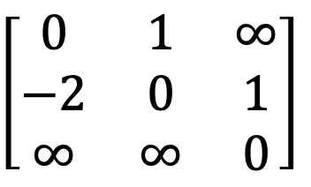
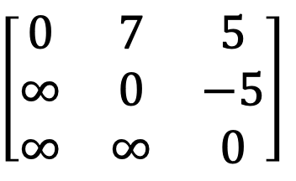
General Weights
5
$$\left[\begin{matrix}0 & 7 & 5 \\ ∞ & 0 & −5 \\ ∞ & ∞ & 0\end{matrix}\right]$$
0
1
2
7
-5
Directed graph with a negative-length edge
-2
$$\left[\begin{matrix}0 & 1 & ∞ \\ −2 & 0 & 1 \\ ∞ & ∞ & 0\end{matrix}\right]$$
0
1
2
1
1
Directed graph with a cycle of negative length
The length of the shortest path from vertex 0 to vertex 2 is $−∞$
0, 1, 0, 1, 0, 1, …, 0, 1, 2

Slide 142
Single Source/All Destinations: General Weights
Dijkstra does not work in such graphs
Bellman & Ford Algorithm:
Using a longer path with some negative-length edges may decrease the cost
When there is no cycle of negative length, there is a shortest path between any two vertices of an n-vertex graph that has at most n-1 edges on it

Slide 143
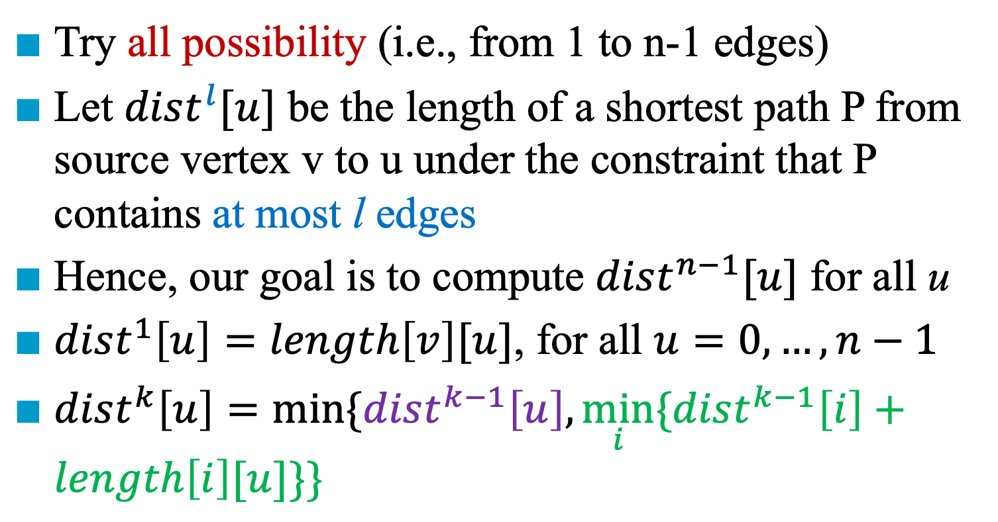
Single Source/All Destinations: General Weights
Try all possibility (i.e., from 1 to n-1 edges)
Let $dist^{l}[u]$ be the length of a shortest path P from source vertex v to u under the constraint that P contains at most l edges
Hence, our goal is to compute $dist^{n−1}[u]$ for all u
$dist^{1}\left[u\right]=length\left[v\right][u]$, for all $u=0,…,n−1$
$dist^{k}\left[u\right]=min\{dist^{k−1}\left[u\right],\min_{i}{\{dist^{k−1}\left[i\right]}+length\left[i\right][u]\}\}$

Slide 144
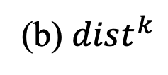
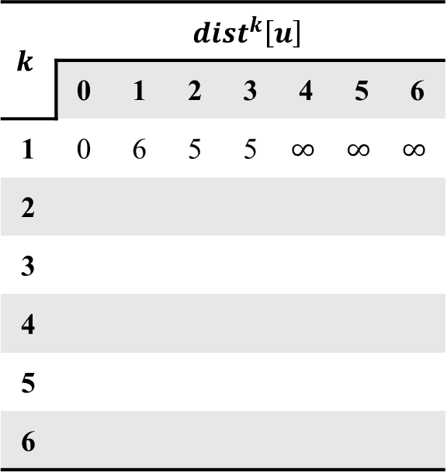
Example
$$k$$ | $$dist^{k}\left[u\right]$$
 | 0 | 1 | 2 | 3 | 4 | 5 | 6
1 | 0 | 6 | 5 | 5 | $$∞$$ | $$∞$$ | $$∞$$
2
3
4
5
6
-1
1
4
6
3
-2
1
0
5
2
6
5
-2
3
-1
3
5
(a) A directed graph
(b) $dist^{k}$

Slide 145
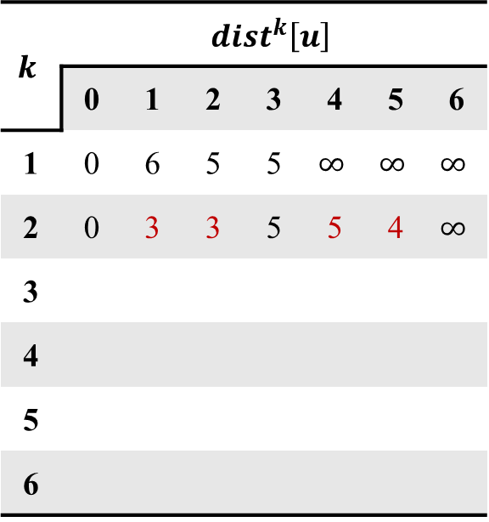
Example
$$k$$ | $$dist^{k}\left[u\right]$$
 | 0 | 1 | 2 | 3 | 4 | 5 | 6
1 | 0 | 6 | 5 | 5 | $$∞$$ | $$∞$$ | $$∞$$
2 | 0 | 3 | 3 | 5 | 5 | 4 | $$∞$$
3
4
5
6
-1
1
4
6
3
-2
1
0
5
2
6
5
-2
3
-1
3
5
(a) A directed graph
(b) $dist^{k}$

Slide 146
Example
$$k$$ | $$dist^{k}\left[u\right]$$
 | 0 | 1 | 2 | 3 | 4 | 5 | 6
1 | 0 | 6 | 5 | 5 | $$∞$$ | $$∞$$ | $$∞$$
2 | 0 | 3 | 3 | 5 | 5 | 4 | $$∞$$
3
4
5
6
-1
1
4
6
3
-2
1
0
5
2
6
5
-2
3
-1
3
5
(a) A directed graph
(b) $dist^{k}$

Slide 147
Example
$$k$$ | $$dist^{k}\left[u\right]$$
 | 0 | 1 | 2 | 3 | 4 | 5 | 6
1 | 0 | 6 | 5 | 5 | $$∞$$ | $$∞$$ | $$∞$$
2 | 0 | 3 | 3 | 5 | 5 | 4 | $$∞$$
3
4
5
6
-1
1
4
6
3
-2
1
0
5
2
6
5
-2
3
-1
3
5
(a) A directed graph
(b) $dist^{k}$

Slide 148
Example
$$k$$ | $$dist^{k}\left[u\right]$$
 | 0 | 1 | 2 | 3 | 4 | 5 | 6
1 | 0 | 6 | 5 | 5 | $$∞$$ | $$∞$$ | $$∞$$
2 | 0 | 3 | 3 | 5 | 5 | 4 | $$∞$$
3
4
5
6
-1
1
4
6
3
-2
1
0
5
2
6
5
-2
3
-1
3
5
(a) A directed graph
(b) $dist^{k}$

Slide 149
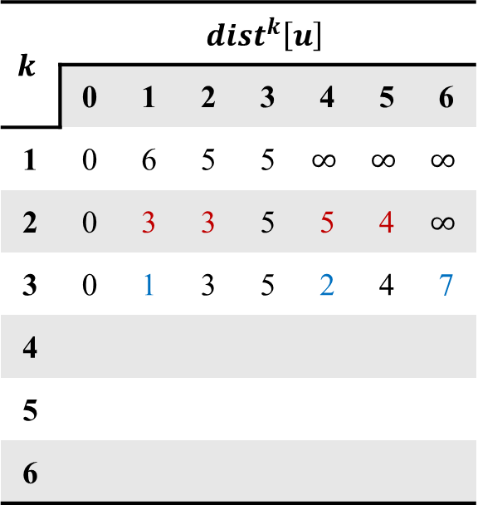
Example
$$k$$ | $$dist^{k}\left[u\right]$$
 | 0 | 1 | 2 | 3 | 4 | 5 | 6
1 | 0 | 6 | 5 | 5 | $$∞$$ | $$∞$$ | $$∞$$
2 | 0 | 3 | 3 | 5 | 5 | 4 | $$∞$$
3 | 0 | 1 | 3 | 5 | 2 | 4 | 7
4
5
6
-1
1
4
6
3
-2
1
0
5
2
6
5
-2
3
-1
3
5
(a) A directed graph
(b) $dist^{k}$

Slide 150
Example
$$k$$ | $$dist^{k}\left[u\right]$$
 | 0 | 1 | 2 | 3 | 4 | 5 | 6
1 | 0 | 6 | 5 | 5 | $$∞$$ | $$∞$$ | $$∞$$
2 | 0 | 3 | 3 | 5 | 5 | 4 | $$∞$$
3 | 0 | 1 | 3 | 5 | 2 | 4 | 7
4
5
6
-1
1
4
6
3
-2
1
0
5
2
6
5
-2
3
-1
3
5
(a) A directed graph
(b) $dist^{k}$

Slide 151
Example
$$k$$ | $$dist^{k}\left[u\right]$$
 | 0 | 1 | 2 | 3 | 4 | 5 | 6
1 | 0 | 6 | 5 | 5 | $$∞$$ | $$∞$$ | $$∞$$
2 | 0 | 3 | 3 | 5 | 5 | 4 | $$∞$$
3 | 0 | 1 | 3 | 5 | 2 | 4 | 7
4
5
6
-1
1
4
6
3
-2
1
0
5
2
6
5
-2
3
-1
3
5
(a) A directed graph
(b) $dist^{k}$

Slide 152
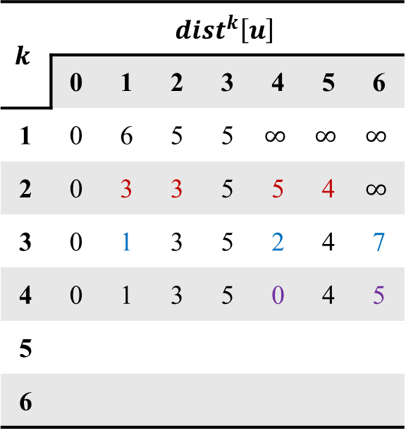
Example
$$k$$ | $$dist^{k}\left[u\right]$$
 | 0 | 1 | 2 | 3 | 4 | 5 | 6
1 | 0 | 6 | 5 | 5 | $$∞$$ | $$∞$$ | $$∞$$
2 | 0 | 3 | 3 | 5 | 5 | 4 | $$∞$$
3 | 0 | 1 | 3 | 5 | 2 | 4 | 7
4 | 0 | 1 | 3 | 5 | 0 | 4 | 5
5
6
-1
1
4
6
3
-2
1
0
5
2
6
5
-2
3
-1
3
5
(a) A directed graph
(b) $dist^{k}$

Slide 153
Example
$$k$$ | $$dist^{k}\left[u\right]$$
 | 0 | 1 | 2 | 3 | 4 | 5 | 6
1 | 0 | 6 | 5 | 5 | $$∞$$ | $$∞$$ | $$∞$$
2 | 0 | 3 | 3 | 5 | 5 | 4 | $$∞$$
3 | 0 | 1 | 3 | 5 | 2 | 4 | 7
4 | 0 | 1 | 3 | 5 | 0 | 4 | 5
5
6
-1
1
4
6
3
-2
1
0
5
2
6
5
-2
3
-1
3
5
(a) A directed graph
(b) $dist^{k}$

Slide 154
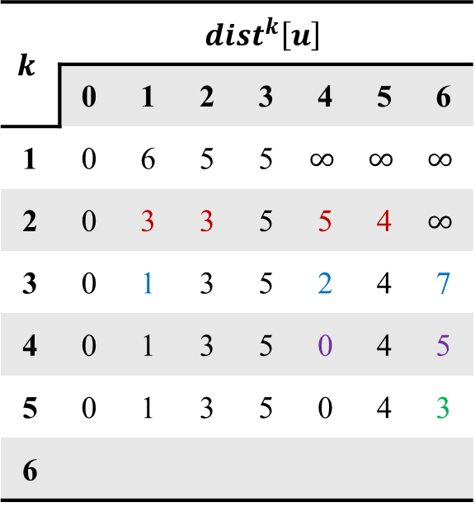
Example
$$k$$ | $$dist^{k}\left[u\right]$$
 | 0 | 1 | 2 | 3 | 4 | 5 | 6
1 | 0 | 6 | 5 | 5 | $$∞$$ | $$∞$$ | $$∞$$
2 | 0 | 3 | 3 | 5 | 5 | 4 | $$∞$$
3 | 0 | 1 | 3 | 5 | 2 | 4 | 7
4 | 0 | 1 | 3 | 5 | 0 | 4 | 5
5 | 0 | 1 | 3 | 5 | 0 | 4 | 3
6
-1
1
4
6
3
-2
1
0
5
2
6
5
-2
3
-1
3
5
(a) A directed graph
(b) $dist^{k}$

Slide 155

Example
$$k$$ | $$dist^{k}\left[u\right]$$
 | 0 | 1 | 2 | 3 | 4 | 5 | 6
1 | 0 | 6 | 5 | 5 | $$∞$$ | $$∞$$ | $$∞$$
2 | 0 | 3 | 3 | 5 | 5 | 4 | $$∞$$
3 | 0 | 1 | 3 | 5 | 2 | 4 | 7
4 | 0 | 1 | 3 | 5 | 0 | 4 | 5
5 | 0 | 1 | 3 | 5 | 0 | 4 | 3
6 | 0 | 1 | 3 | 5 | 0 | 4 | 3
-1
1
4
6
3
-2
1
0
5
2
6
5
-2
3
-1
3
5
(a) A directed graph
(b) $dist^{k}$

Slide 156
Bellman & Ford Algorithm
void BellmanFord(int n, int v)
{
int i, k;
for (i = 0; i < n; i ++)
distance[i] = cost[v][i];
for (k = 2; k <= n-1; k ++)
for (each u such that u != v and u has at least one incoming edge)
for (each <i,u> in the graph)
if (dist[u] > dist[i] + length[i][u])
dist[u] = dist[i] + length[i][u];
}
// edge number ranges from 2 to n-1
O(n³)

Slide 158
All Pairs Shortest Paths
Find the shortest paths between all pairs of vertices
Naïve Solution
Apply shortest path n times with each vertex as source
Time complexity = O(n³)
But, if the graph have negative weights (no negative cycle)…

Slide 159
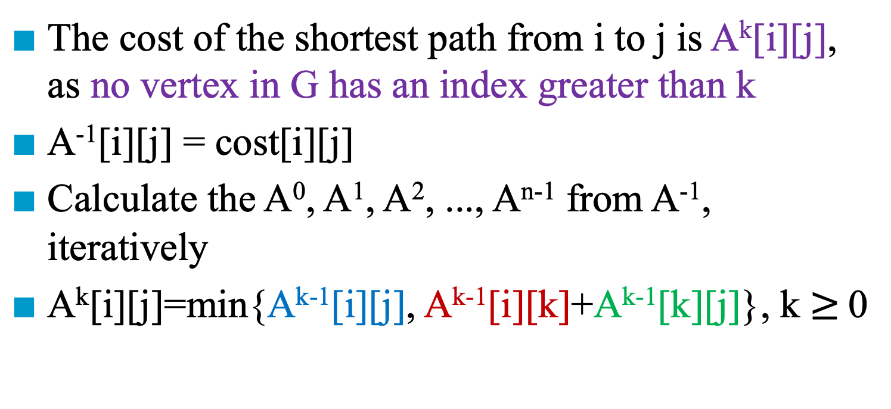
All Pairs Shortest Paths
The cost of the shortest path from i to j is A^{k}[i][j], as no vertex in G has an index greater than k
A⁻¹[i][j] = cost[i][j]
Calculate the A⁰, A¹, A², ..., A^{n-1} from A⁻¹, iteratively
A^{k}[i][j]=min{A^{k-1}[i][j], A^{k-1}[i][k]+A^{k-1}[k][j]}, k $≥$0
k
1, …, k-1
1, …, k-1
1, …, k-1
i
j

Slide 160
Example
6
V₀
V₁
4
11
2
3
V₂
(a) Digraph G (b) Cost adjacency matrix for G

Slide 161
A⁰
A⁻¹
A⁻¹
From 0 to 0:
0 0
6 4
3 11
From 0 to 0
From 1 to 0:
From 0 to 1
From 2 to 0:
From 0 to 2
v₀
A⁰[2][1] = min{A⁻¹[2][1], A⁻¹[2][0]+A⁻¹[0][1]} = {$∞$, 3+4} = 7

Slide 162
A⁰
A¹
A⁰
From 0 to 1:
4 6
0 0
7 2
From 1 to 0
From 1 to 1:
From 1 to 1
From 2 to 1:
From 1 to 2
v₁
A¹[0][2] = min{A⁰[0][2], A⁰[0][1]+A⁰[1][2]} = {11, 4+2} = 6

Slide 163
A¹
A²
A¹
From 0 to 2:
6 3
2 7
0 0
From 2 to 0
From 1 to 2:
From 2 to 1
From 2 to 2:
From 2 to 2
v₂
A²[1][0] = min{A¹[1][0], A¹[1][2]+A¹[2][0]} = {6, 2+3} = 5

Slide 164
Algorithm for All Pairs Shortest Paths
void allCosts(int cost[][MAX_VERTICES],
int distance[][MAX_VERTICES],
int n)
{
int i, j, k;
for (i = 0; i < n; i ++)
for (j = 0; j < n; j ++) distance[i][j] = cost[i][j];
for (k = 0; k < n; k ++)
for (i = 0; i < n; i ++)
for (j = 0; j < n; j ++)
if (distance[i][k] + distance[k][j] < distance[i][j])
distance[i][j]= distance[i][k]+distance[k][j];
}

Slide 166
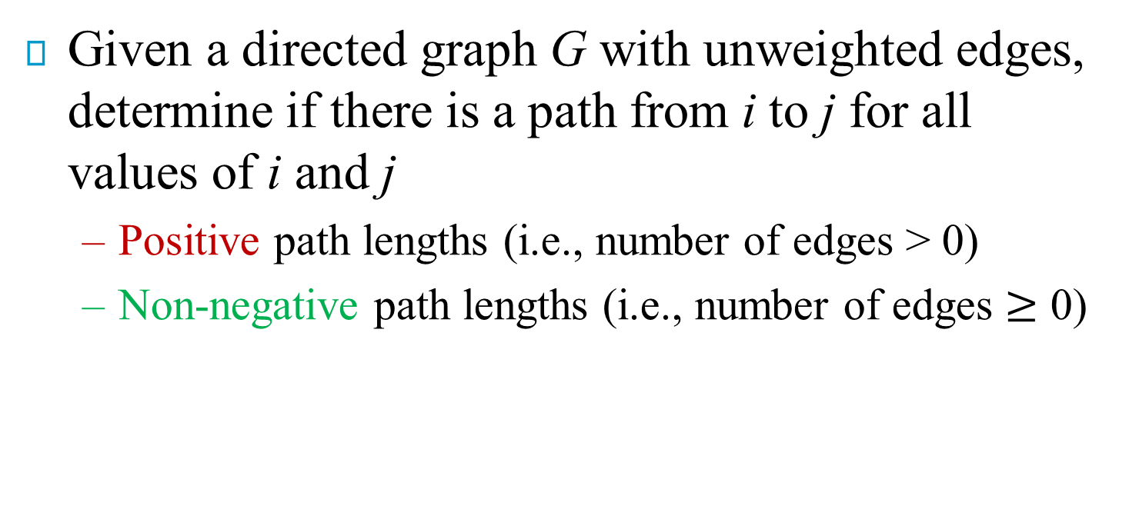
Transitive Closure
Given a directed graph G with unweighted edges, determine if there is a path from i to j for all values of i and j
Positive path lengths (i.e., number of edges > 0)
Non-negative path lengths (i.e., number of edges $≥$ 0)
0 1 2 3 4
0
1
2
3
4
0
1
2
3
4
(a) Digraph G
(b) Adjacency matrix A for G

Slide 167
Transitive Closure Matrix
The transitive closure matrix, denoted A⁺, of a directed graph, G, is a matrix such that A⁺[i][j] = 1 if there is a path of length > 0 from i to j; otherwise, A⁺[i][j] = 0
i.e., positive path lengths
0 1 2 3 4
0
1
2
3
4
0
1
2
3
4
cycle
(a) Digraph G
(c) transitive closure matrix A⁺

Slide 168
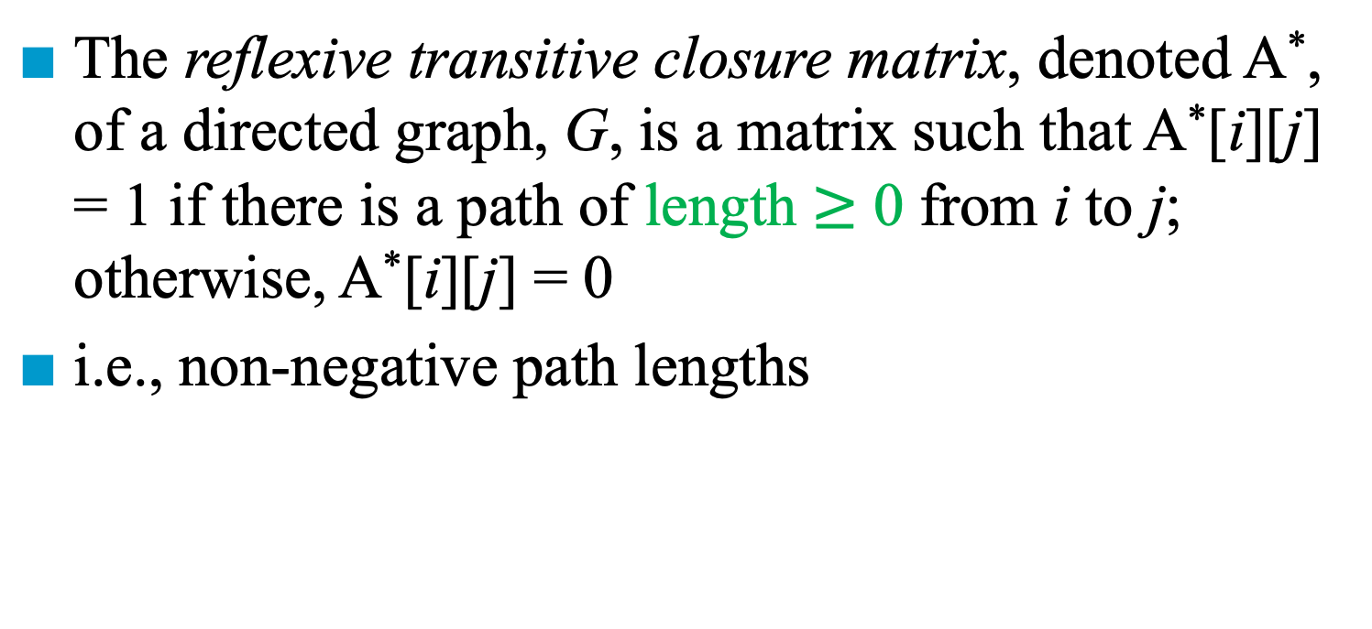
Reflexive Transitive Closure Matrix
The reflexive transitive closure matrix, denoted A*, of a directed graph, G, is a matrix such that A*[i][j] = 1 if there is a path of length $≥$ 0 from i to j; otherwise, A*[i][j] = 0
i.e., non-negative path lengths
0 1 2 3 4
0
1
2
3
4
0
1
2
3
4
reflexive
(a) Digraph G
(d) reflexive transitive closure matrix A*

Slide 169
Algorithm
We can use allCosts (i.e., the algorithm for all pair shortest paths) with a simple modification
Change the if statement in the nested for loops to:
distance[i][j] = distance[i][j] || distance[i][k]
&& distance[k][j]
Time complexity: O(n³)

Slide 171
Activity-on-Vertex (AOV) Networks
Definition:
A directed graph
Vertices represent tasks or activities
Edges represent precedence relations between tasks
Predecessor and Successor
Vertex i is a predecessor of vertex j iff there is a directed path from i to j
If vertex i is a predecessor of vertex j, then j is a successor of i
Vertex i is an immediate predecessor of vertex j iff <i, j> is an edge in G
If vertex i is an immediate predecessor of vertex j, then j is an immediate successor of i

Slide 172
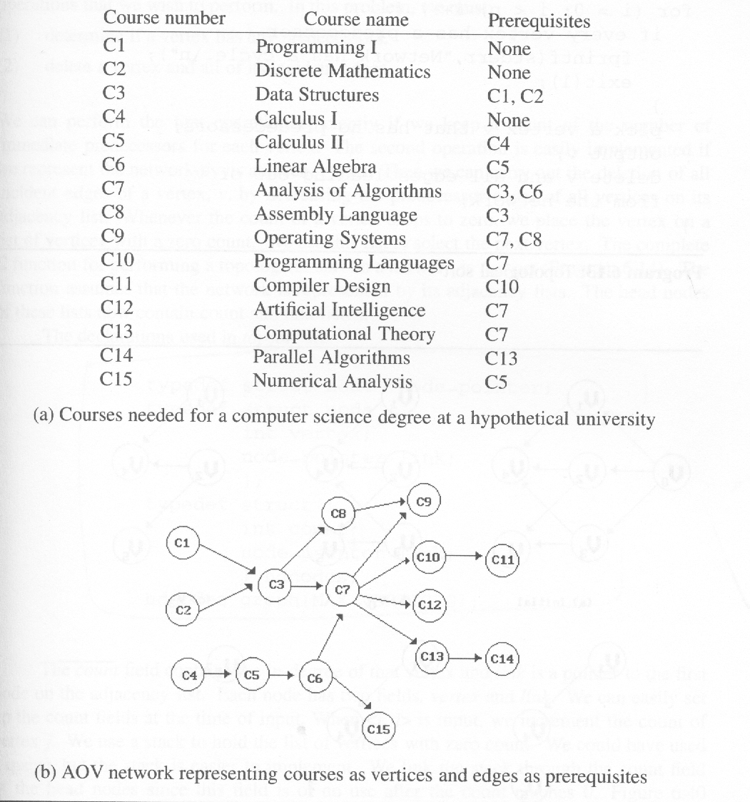
*Figure 6.37: An AOV network (p.316)

Slide 173
*Figure 6.37: An AOV network (p.316)

Slide 174
Topological Order
Definition:
Linear ordering of vertices of a graph such that:
Any two vertices i and j, if i is a predecessor of j, then i precedes j in the linear ordering
Example:
C1, C2, C4, C5, C3, C6, C8, C7, C10, C13, C12, C14, C15, C11, C9
C4, C5, C2, C1, C6, C3, C8, C15, C7, C9, C10, C11, C13, C12, C14

Slide 175
Find Topological Order
0 → 3 → 2 → 5 → 1 → 4
1
1
1
0
2
4
2
4
2
4
3
5
3
5
5
(a) Initial
(b) Vertex 0 deleted
(c) Vertex 3 deleted
1
1
4
4
4
5
(d)Vertex 2 deleted
(e) Vertex 5 deleted
(f) Vertex 1 deleted

Slide 176
*Program 6.13: Design of an algorithm for topological sorting (p.318)
Algorithm for Topological Sorting
Input the AOV network. Let n be the number of vertices. for (i = 0; i <n; i++) /* output the vertices */
{ if (every vertex has a predecessor) return;
/* network has a cycle and infeasible */
pick a vertex v that has no predecessors; output v; delete v and all edges leading out of v; }

Slide 177
*Figure 6.49: Internal representation used by topological sorting algorithm (p.320)
count
first
data
link
[0]
[1]
[2]
0 •
1 •
2 •
3 NULL
1 •
4 NULL
1 •
4 •
5 NULL
[3]
1 •
5 •
4 NULL
v1
[4]
3 NULL
v0
v2
v4
[5]
2 NULL
v3
v5

Slide 178
Representation
typedef struct node *nodePointer; typedef struct node { int vertex; nodePointer link; }; typedef struct { int count; nodePointer first; } hdnodes; hdnodes graph[MAX_VERTICES];

Slide 179
*Program 6.14: Topological sort (p.308)
void topSort (hdnodes graph [], int n) { int i, j, k, top; nodePointer ptr; /* create a stack of vertices with no predecessors */ top = -1; for (i = 0; i < n; i++) if (!graph[i].count) { graph[i].count = top; // use “count” as a pointer top = i;
}
for (i = 0; i < n; i++) if (top == -1) { fprintf(stderr, “\n Network has a cycle. Sort
terminated. \n”); exit(1); }
O(n)

Slide 180
else { j = top; /* unstack a vertex */ top = graph[top].count; printf(“v%d, “, j);
for (ptr = graph [j]. link; ptr ;ptr = ptr ->link ){ /* decrease the count of the successor vertices of j */ k = ptr ->vertex; graph[k].count --; if (!graph[k].count) { /* add vertex k to the stack*/ graph[k].count = top; top = k; } } } }
d_{k} is the out-degree of node k
d₀+d₁+…+d_{n-1}=O(e)
Time complexity = O(e+n)

Slide 182




Activity-on-Edge (AOE) Networks

Slide 183
Activity-on-Edge (AOE) Networks
Definition:
A directed graph
Vertices represent events which signal the completion of certain activities
Edges represent tasks or activities to be performed
Edge weights represent time required to perform the activities
Find the minimum time to complete the tasks
Find the critical tasks in the network
Application: project

Slide 184
Example
1
6
a₄ = 1
a₁₀ = 2
a₁ = 6
a₇ = 9
0
4
8
a₂ = 4
finish
start
a₅ = 1
a₈ = 7
a₁₁ = 4
2
7
a₃ = 5
event | interpretation
0 | start of project
1 | completion of activity a₁
4 | completion of activity a₄ and a₅
7 | completion of activity a₈ and a₉
8 | completion time of project
a₉ = 4
3
5
a₆ = 2

Slide 185
Example
event | interpretation
0 | start of project
1 | completion of activity a₁
4 | completion of activity a₄ and a₅
7 | completion of activity a₈ and a₉
8 | completion time of project

Slide 186
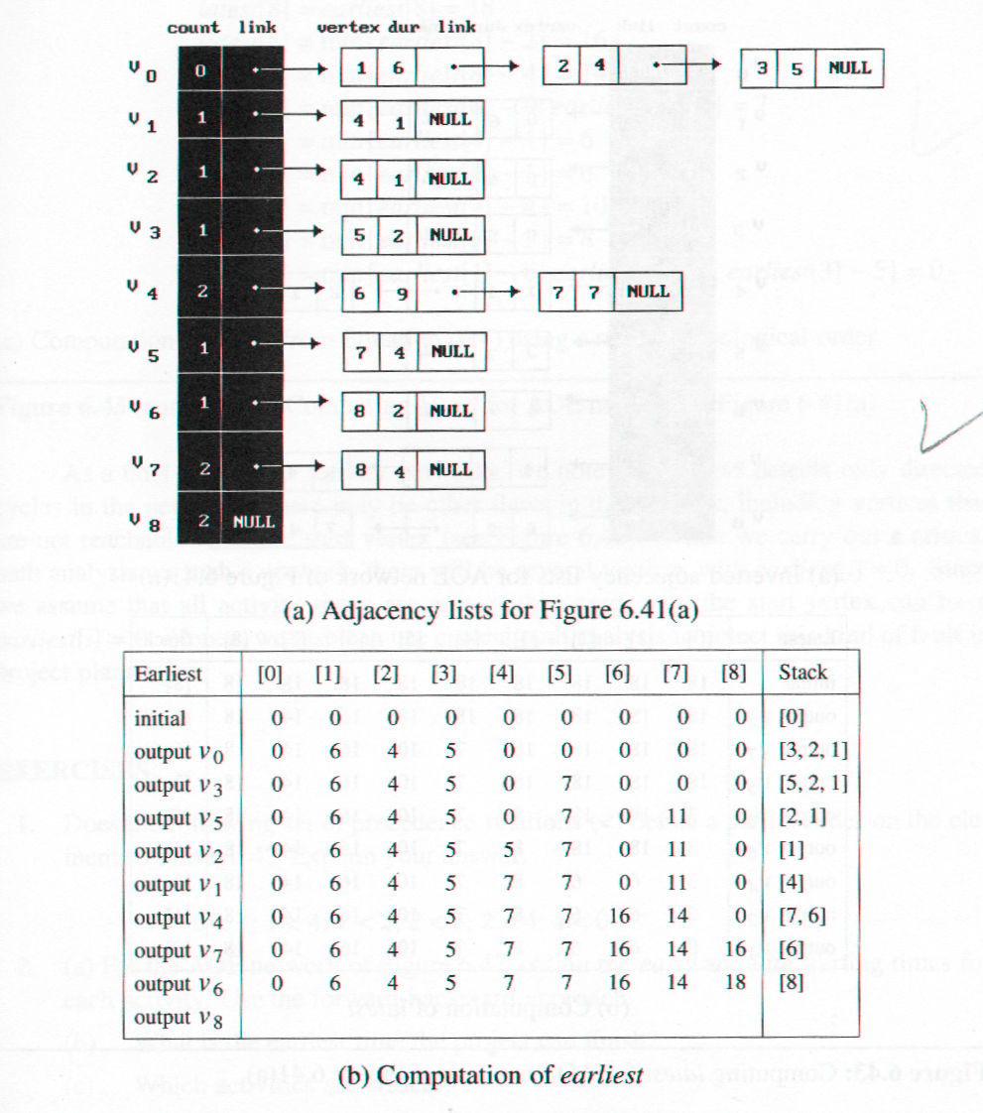
*Figure 6.41(a): Adjacency lists for Figure 6.40 (a) (p.325)
first

Slide 188
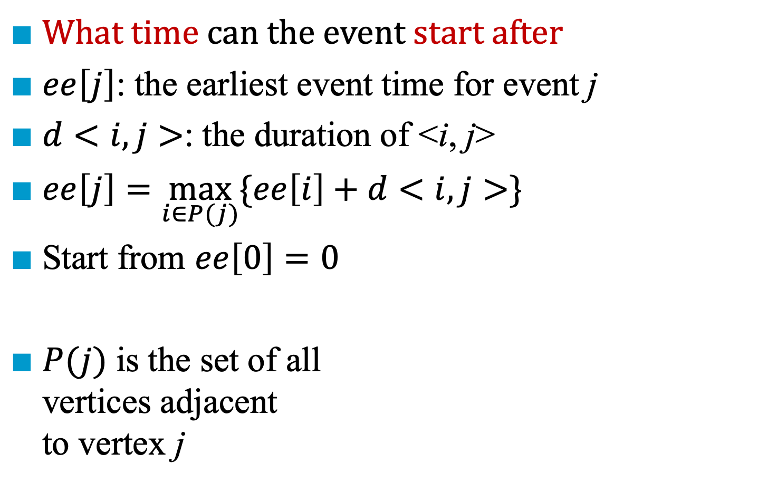
Early Event Time (ee)
What time can the event start after
$ee\left[j\right]$: the earliest event time for event j
$d<i,j>$: the duration of <i, j>
$ee\left[j\right]=\max_{i∈P(j)}{\{ee\left[i\right]+d<i,j>\}}$
Start from $ee\left[0\right]=0$
$P(j)$ is the set of all vertices adjacent to vertex j
1
6
a₄ = 1
a₁₀ = 2
a₁ = 6
a₇ = 9
0
4
8
a₁ = 4
finish
start
a₅ = 1
a₈ = 7
a₁₁ = 4
2
7
a₃ = 5
a₉ = 4
5
3
5
a₆ = 2
Notes:
最早在什麼時候這個 event （里程碑）可以到達？

Slide 189
*Figure 6.41(b): Compute of ee (p.325)
ee
18
We compute the earliest event time, ee[j]
We use topological sorting to generate the sequence

Slide 190
*Figure 6.41(b): Compute of ee (p.325)
ee
18
We compute the earliest event time, ee[j]
We use topological sorting to generate the sequence

Slide 191
*Figure 6.41(b): Compute of ee (p.325)
ee
18
We compute the earliest event time, ee[j]
We use topological sorting to generate the sequence

Slide 192
*Figure 6.41(b): Compute of ee (p.325)
ee
18
We compute the earliest event time, ee[j]
We use topological sorting to generate the sequence

Slide 193
*Figure 6.41(b): Compute of ee (p.325)
ee
18
We compute the earliest event time, ee[j]
We use topological sorting to generate the sequence

Slide 194
*Figure 6.41(b): Compute of ee (p.325)
ee
18
We compute the earliest event time, ee[j]
We use topological sorting to generate the sequence

Slide 195
*Figure 6.41(b): Compute of ee (p.325)
ee
18
We compute the earliest event time, ee[j]
We use topological sorting to generate the sequence

Slide 196
*Figure 6.41(b): Compute of ee (p.325)
ee
18
We compute the earliest event time, ee[j]
We use topological sorting to generate the sequence

Slide 198
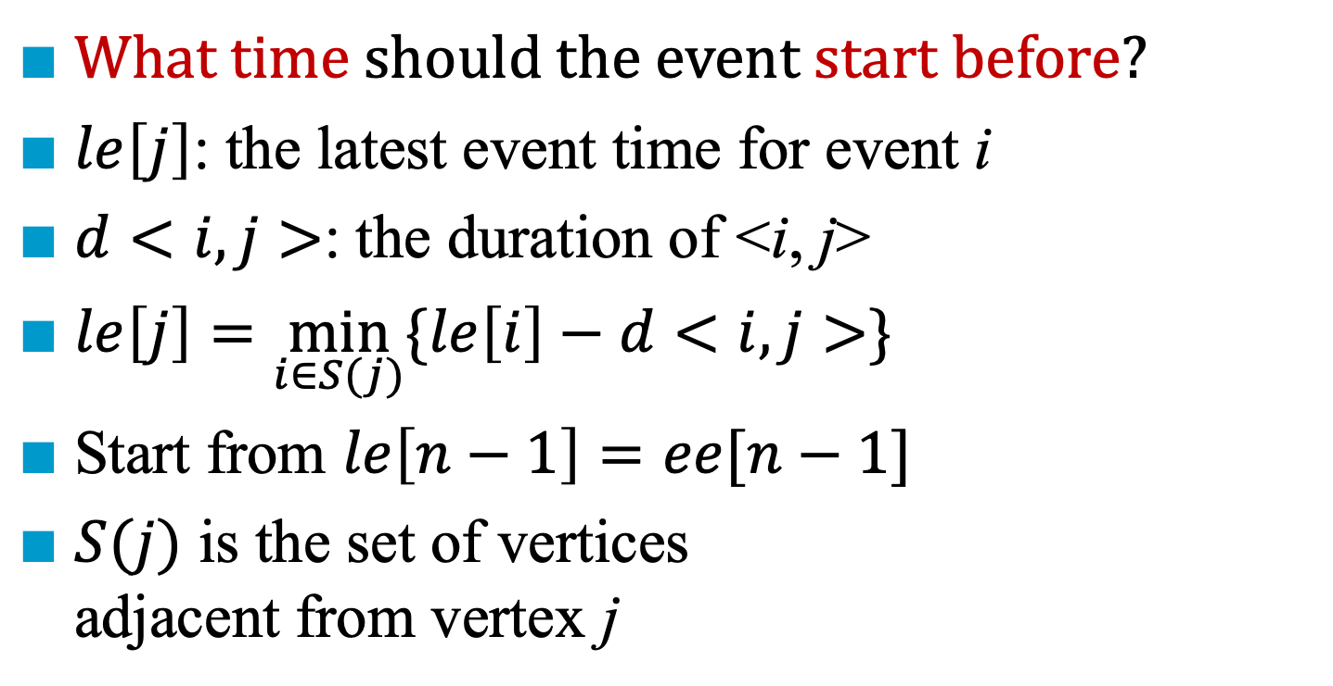
Late Event Time (le)
What time should the event start before?
$le\left[j\right]$: the latest event time for event i
$d<i,j>$: the duration of <i, j>
$le\left[j\right]=\min_{i∈S(j)}{\{le\left[i\right]−d<i,j>\}}$
Start from $le\left[n−1\right]=ee[n−1]$
$S(j)$ is the set of vertices adjacent from vertex j
1
6
a₄ = 1
a₁₀ = 2
a₁ = 6
a₇ = 9
0
4
8
a₁ = 4
finish
start
a₅ = 1
a₈ = 7
a₁₁ = 4
2
7
a₃ = 5
a₉ = 4
5
3
5
a₆ = 2
Notes:
最晚在什麼時候這個 event （里程碑）需要開工？如果希望不要delay

Slide 199
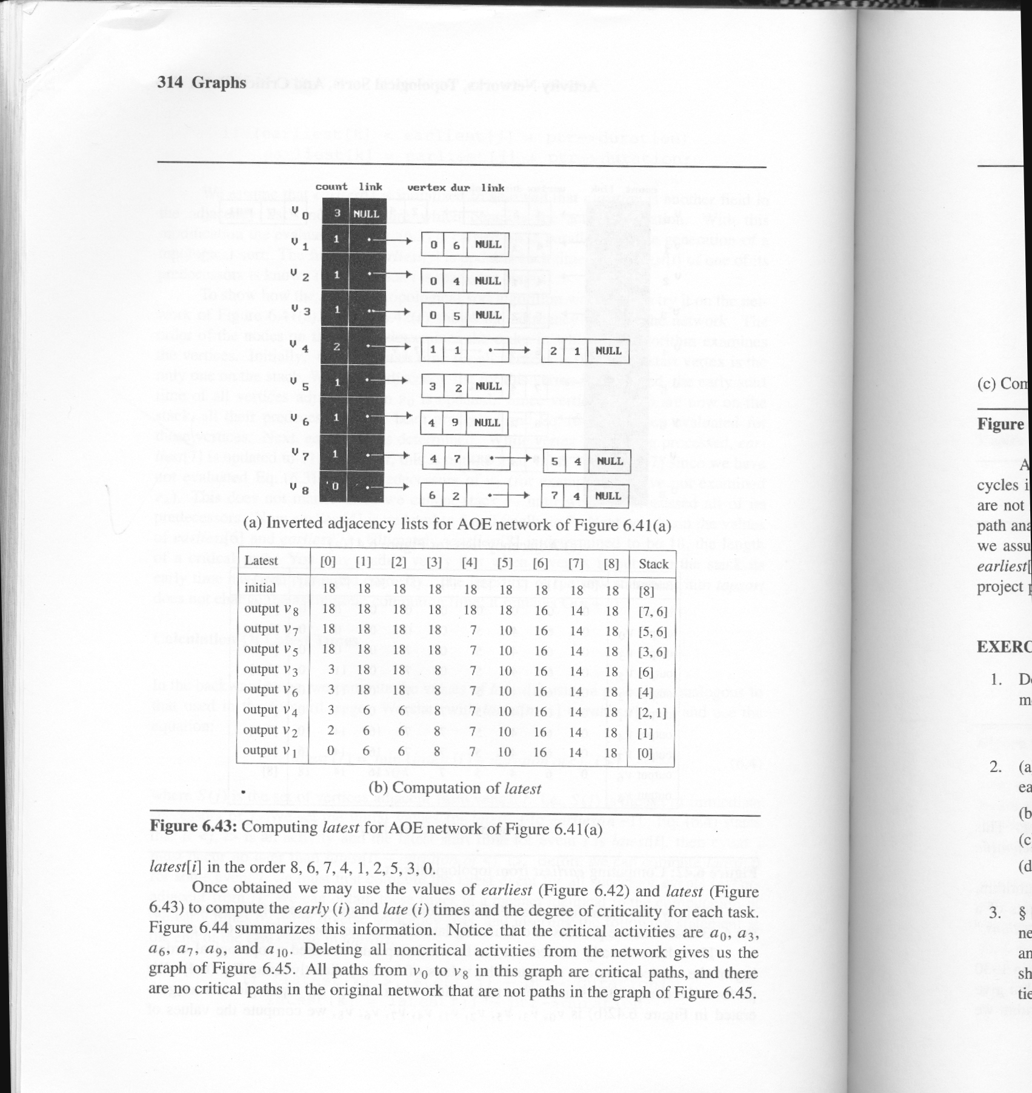
first

Slide 200
le
We compute the latest event time, le[j]
We use reverse topological sorting to generate the sequence

Slide 201
le
We compute the latest event time, le[j]
We use reverse topological sorting to generate the sequence

Slide 202
le
We compute the latest event time, le[j]
We use reverse topological sorting to generate the sequence

Slide 203
le
We compute the latest event time, le[j]
We use reverse topological sorting to generate the sequence

Slide 204
le
We compute the latest event time, le[j]
We use reverse topological sorting to generate the sequence

Slide 205
le
We compute the latest event time, le[j]
We use reverse topological sorting to generate the sequence

Slide 206
le
We compute the latest event time, le[j]
We use reverse topological sorting to generate the sequence

Slide 207
le
We compute the latest event time, le[j]
We use reverse topological sorting to generate the sequence

Slide 209
Critical Path Analysis
1
6
a₄ = 1
a₁₀ = 2
To identify critical activities so that resources may be concentrated on these activities in an attempt to reduce project completion time
a₁ = 6
a₇ = 9
0
4
8
a₂ = 4
finish
start
a₅ = 1
a₈ = 7
a₁₁ = 4
2
7
a₃ = 5
a₉ = 4
3
5
a₆ = 2

Slide 210
Critical Path Analysis
1
6
a₄ = 1
a₁₀ = 2
Activity a_{i} is presented by edge <k, l>
Find the early and late activity times of activity a_{i}
What time the activity can start after (e)
What time the activity should start before (l)
a₁ = 6
a₇ = 9
0
4
8
a₁ = 4
finish
start
a₅ = 1
a₈ = 7
a₁₁ = 4
2
7
a₃ = 5
ee | [0] | [1] | [2] | [3] | [4] | [5] | [6] | [7] | [8]
 | 0 | 6 | 4 | 5 | 7 | 7 | 16 | 14 | 18
a₉ = 4
5
3
5
le | [0] | [1] | [2] | [3] | [4] | [5] | [6] | [7] | [8]
 | 0 | 6 | 6 | 8 | 7 | 10 | 16 | 14 | 18
a₆ = 2

Slide 211
Critical Path Analysis
1
6
a₄ = 1
a₁₀ = 2
Activity a_{i} is presented by edge <k, l>
Find the early and late activity times of activity a_{i}
e(i) = ee[k]
l(i) = le[l] – duration of activity a_{i}
a₁ = 6
a₇ = 9
0
4
8
a₁ = 4
finish
start
a₅ = 1
a₈ = 7
a₁₁ = 4
2
7
ee | [0] | [1] | [2] | [3] | [4] | [5] | [6] | [7] | [8]
 | 0 | 6 | 4 | 5 | 7 | 7 | 16 | 14 | 18
a₃ = 5
a₉ = 4
e(1) = ee[0] = 0
e(2) = ee[0] = 0
e(3) = ee[0] = 0
e(4) = ee[1] = 6
e(5) = ee[2] = 4
e(6) = ee[3] = 5
e(7) = ee[4] = 7
e(8) = ee[4] = 7
5
e(9) = ee[5] = 7
e(10) = ee[6] = 16
e(11) = ee[7] = 14
3
5
a₆ = 2

Slide 212
Critical Path Analysis
1
6
a₄ = 1
a₁₀ = 2
Activity a_{i} is presented by edge <k, l>
Find the early and late activity times of activity a_{i}
e(i) = ee[k]
l(i) = le[l] – duration of activity a_{i}
a₁ = 6
a₇ = 9
0
4
8
a₁ = 4
finish
start
a₅ = 1
a₈ = 7
a₁₁ = 4
2
7
le | [0] | [1] | [2] | [3] | [4] | [5] | [6] | [7] | [8]
 | 0 | 6 | 6 | 8 | 7 | 10 | 16 | 14 | 18
a₃ = 5
a₉ = 4
l(1) = le[1] – 6 = 6 – 6 = 0
l(2) = le[2] – 4 = 6 – 4 = 2
l(3) = le[3] – 5 = 8 – 5 = 3
l(4) = le[4] – 1 = 7 – 1 = 6
l(5) = le[4] – 1 = 7 – 1 = 6
l(6) = le[5] – 2 = 10 – 2 = 8
l(7) = le[6] – 9 = 16 – 9 = 7
l(8) = le[7] – 7 = 14 – 7 = 7
5
3
5
a₆ = 2
l(9) = le[7] – 4 = 10
l(10) = le[8] – 2 = 16
l(11) = le[8] – 4 = 14

Slide 213
*Figure 6.42: Early, late and critical values (p.327)

Slide 215
Example
7
0 1 6
0 2 4
1 3 5
2 3 1
4 5 2
5 3 9
4 3 1
4
a₅ = 2
5
finish
1
a₇ = 1
a₁ = 6
a₃ = 5
a₆ = 9
0
3
a₂ = 4
start
a₄ = 1
2

